Slide 2
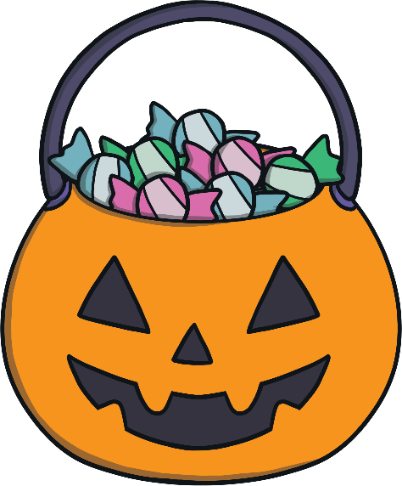
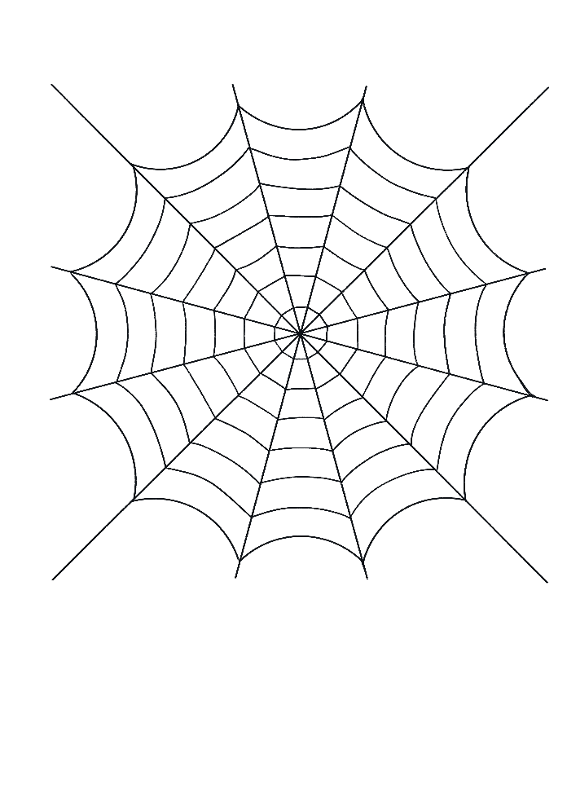
Aim
To explain where Halloween and its name came from.
To explain where the idea of dressing up at Halloween came from.
To explain where the tradition of making jack-o-lanterns came from.
To explain where the tradition of trick or treating at Halloween came from.
To complete a quiz about the history of Halloween.

Slide 3
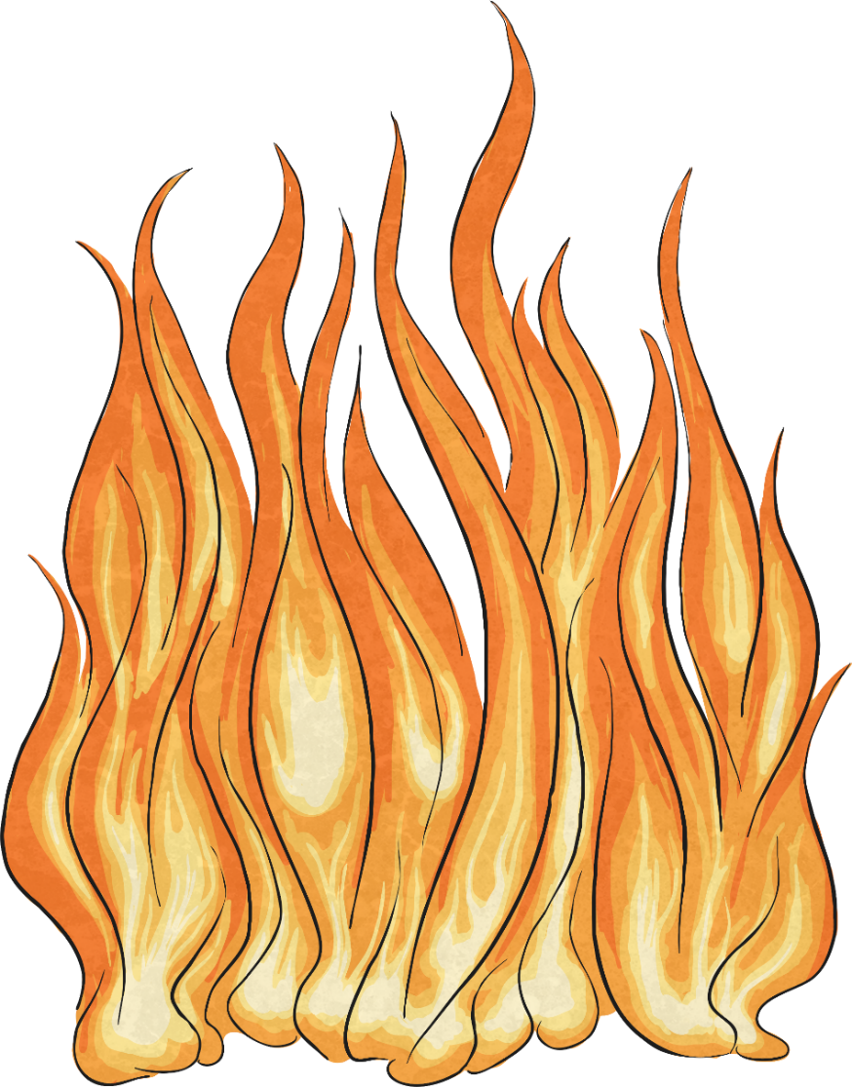
Where did Halloween come from?
In the beginning, Halloween was a harvest festival.
The Celts (who lived in Ireland, the United Kingdom and France) marked the end of the summer and the beginning of winter with this harvest festival.
They called the festival Samhain (sow-in) and this translated to ‘the end of summer’.
They believed that the festival would make their gods happy so they would protect them and their crops during the long, hard winter that was to come.
They wore costumes and enjoyed fortune telling.
They built huge fires, and burned crops and animals as sacrifices.

Slide 4
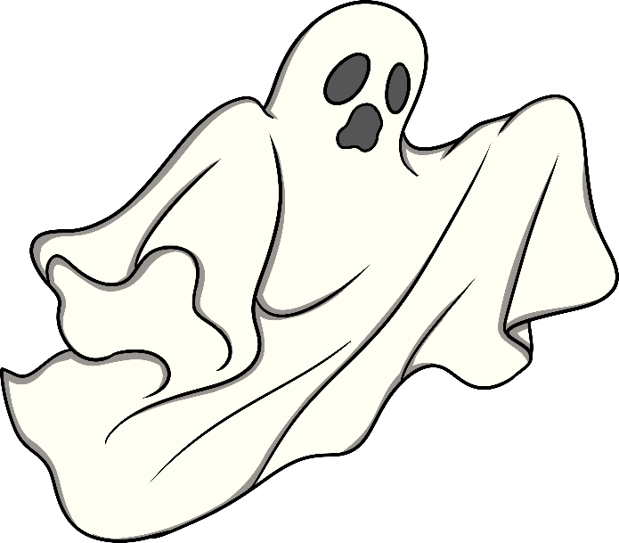
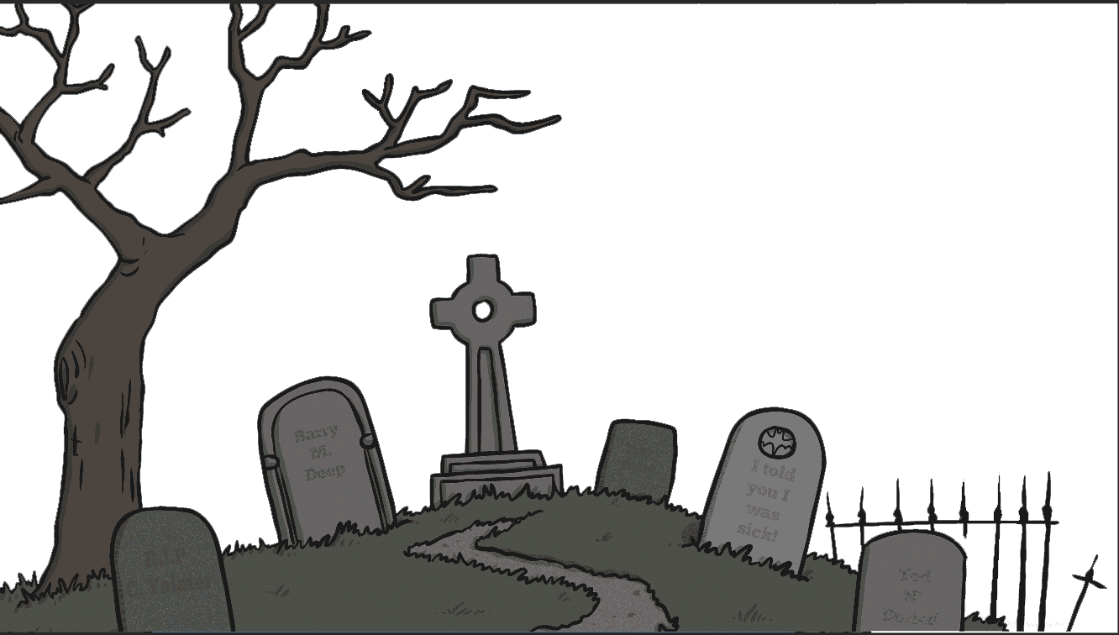
Where did the name Hallowe’en come from?
When the Celts eventually became Christian, they started to call the first day
of November ‘All Saints’ Day’.
‘All Saints’ Day’ was also called ‘All-hallows’ which was an old English word.
People began to call the night before the first of November, ‘All-hallows Eve’ and this eventually became Halloween.

Slide 5
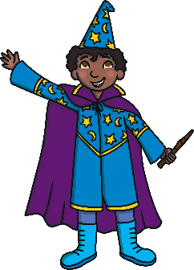
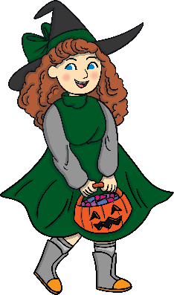
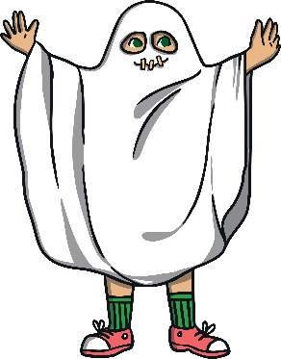
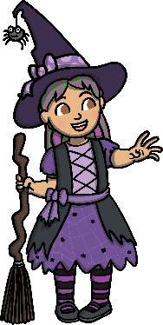
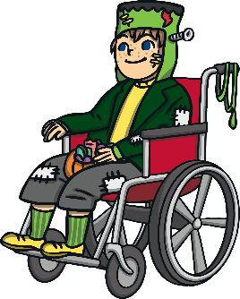
Why do people dress in costumes at Halloween?
People believed that ghosts walked the streets on Halloween night and they felt scared about meeting them.
They began to wear masks to fool the ghosts into believing that they were other spirits.
Soon, people started to wear costumes and fancy dress to go with the masks.

Slide 6
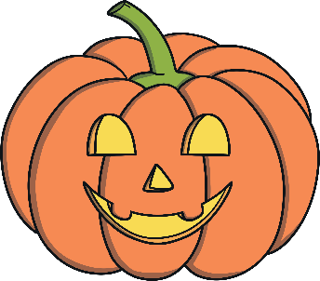
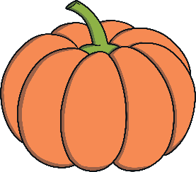
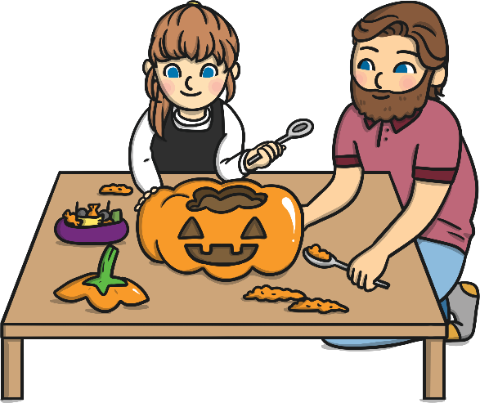
Why do we make Jack-o’-lanterns at Hallowe’en?
There was an old Irish legend about a very mean and sly man called Jack who was always playing tricks on people. When he died, he was not allowed into heaven or hell so he had to walk the Earth from then on. The only thing Jack had to guide him on his way was a hollowed out turnip with a light inside it.
This is where we get the name ‘Jack of the Lantern’ which changed to ‘jack-o’-lantern’.
When European settlers arrived in America, they realised that pumpkins would be far easier to carve as they were soft and would give out a brighter orange coloured light, than the turnips.
Nowadays, most jack-o’-lanterns are carved from pumpkins for this reason.

Slide 7
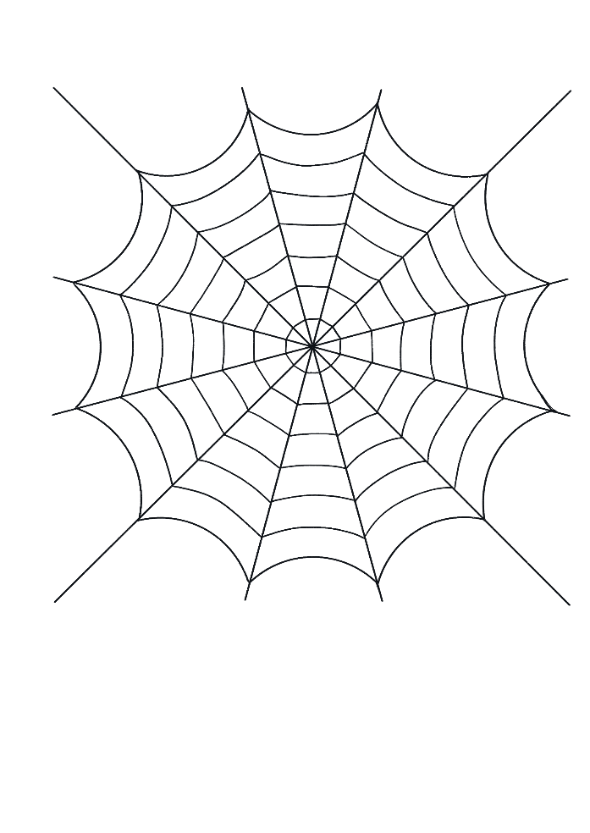
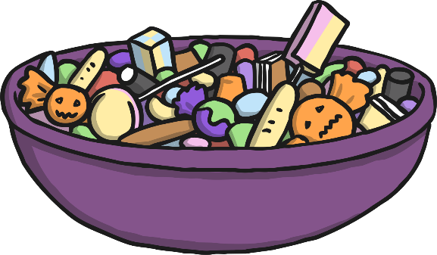
Why do we go trick or treating at Halloween?
Many years ago, people were not just afraid of meeting ghosts on Halloween night. They were also terrified that ghosts or spirits would come into their homes.
They began leaving bowls of food outside their doors to deter the ghosts from entering.
Over time, people began to get less fearful of the ghosts and started eating the nice treats themselves.
Some people say that this was the start of trick or treating.
There are other stories that claim trick or treating started when people started giving cakes in return for prayers being said for their dead relatives on All Soul’s Day in England.
Instead of just getting cakes, children began visiting their neighbours to look for food, drinks and money as well.

Slide 8
Quiz
Who were the first people to hold a festival called Samhain?
A
The Vikings
B
The Egyptians
C
The Celts
D
The Romans

Slide 9
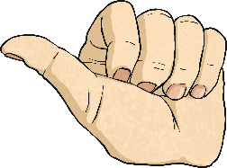
Correct
Well done!
next

Slide 10
Good try!
Give it another go!
back

Slide 11
Quiz
The first Jack-o’-lanterns were made of…
A
turnip
B
melon
C
pumpkin
D
cabbage

Slide 12
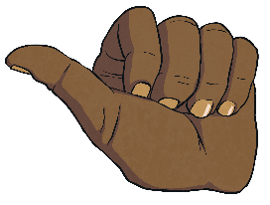
Correct
Well done!
next

Slide 13
Good try!
Give it another go!
back

Slide 14
Quiz
People began to wear masks and dress in costumes at Halloween because…
A
They wanted to wear colourful clothes
B
They wanted to fool evil spirits
C
They wanted to blend into their surroundings
D
They enjoyed making masks

Slide 15
Correct
Well done!
next

Slide 16
Good try!
Give it another go!
back

Slide 17
Quiz
The tradition of carving Jack-o’-lanterns from pumpkins first originated in…
A
Ireland
B
America
C
Germany
D
Scotland

Slide 18
Correct
Well done!
next

Slide 19
Good try!
Give it another go!
back

Slide 20
Quiz
The word Hallowe’en comes from an old English word for…
A
harvest festival
B
November
C
Winter
D
All Saints’ Day

Slide 21
Correct
Well done!
next

Slide 22
Good try!
Give it another go!
back

Slide 23
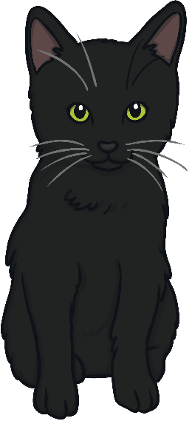
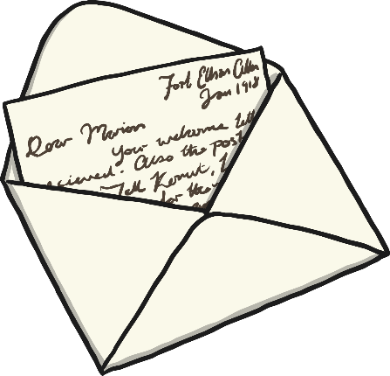
Activity
Write a short letter to the Celts who celebrated the first Halloween.
Tell them about the traditions you enjoy during Halloween nowadays and how they differ from the traditions you learned about in this presentation.

